Slide 1
Kids Ability

Slide 2
What is kids ability
Kids ability is an organization that helps kids from the age of birth-18 years of age. They give kids with wide ranges of special needs. Kids with disabilities, and medical syndromes and much more.

Slide 3
Mission
made a positive difference in our community enhancing the future of the children served by KidsAbility and the families who have entrusted them to us
raised sufficient funds for KidsAbility Centre for Child Development to fulfill its mission by meeting the needs of all those who have been referred to receive the services it offers
enhanced the awareness of KidsAbility as well as the respect and support for its services and, in so doing, extended its base of financial support to enable it to meet the needs of all those entrusted to it into the foreseeable future

Slide 4
Funding
6.8 % is spent on equipment and materials
0.5% other
44.7% direct therapy
3% capital/ IT
15.2% Strategic initiatives
5.8% Pediatrician support
24% Kitchener site capital
Ontario Ministry of Children and Youth Services and ErinoakKids funds kids ability

Slide 5
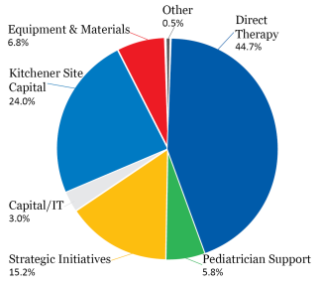
Diagram in % on what goes where

Slide 6
Easy breakdown on funding
$1,541,232 Money given to Kids Ability Centre for Child Development
$8,683 Money given to Kids Ability School
$335,497 Salaries and Benefits to Kids Ability Foundation staff
$75,169 Fundraising costs incurred by Kids Ability Foundation

Slide 7
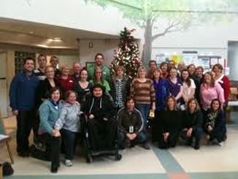
Staff
There are currently 235 working staff at kids ability
The staff help all the kids that need the help and provide them with special care.

