Slide 1
KENYA

Slide 2
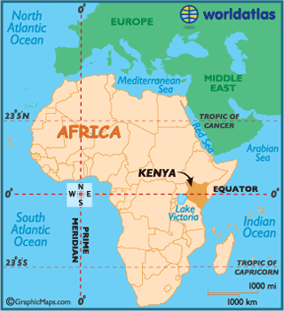
Where Kenya is

Slide 3
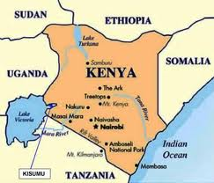
Neighbors

Slide 4
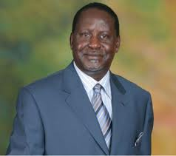
Kenya president

Slide 5
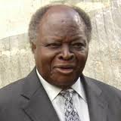
Kenya president
Mwai Kibaki

Slide 6
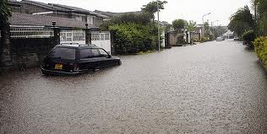
Conflict in Kenya

Slide 7
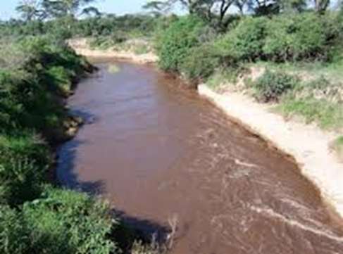
Conflict in kenya

Slide 8
Kenya flag

Slide 9
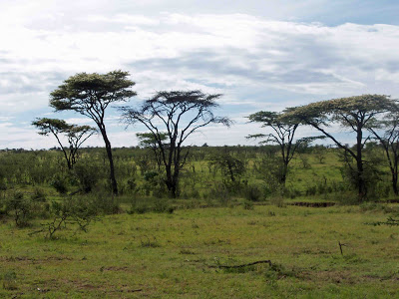
Landscape in Kenya

Slide 10
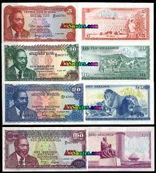
Money in Kenya

Slide 11
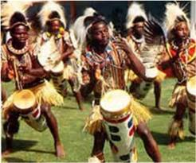
Culture

Slide 12
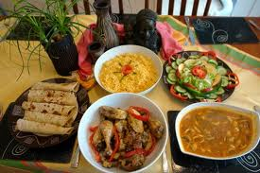
Culture food

Slide 13
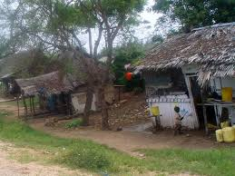
Houses

